Slide 1
Water Cycle – A-level resource pack
River Culm catchment
Teachers’ Notes

Slide 2
The water cycle in the River Culm catchment
The water cycle is a key topic studied at A level.
Students need to understand the components and mechanisms associated with the global water cycle and its applications at the regional and local scale.
Rivers and catchments play an important part in the global water cycle, providing stores and transfer processes.
The River Culm catchment provides an excellent case study of a small rural river basin with water stores and transfer processes in a constant state of flux. Highly responsive to rainfall events particularly in the winter, the Culm is characterised by having a high proportion of runoff which presents challenges associated with flood management.

Slide 3
Teaching resources
There are two sets of resources:
A Powerpoint presentation providing students with an illustrated study of the water cycle focusing on the River Culm catchment. The presentation begins with an overview of the global water cycle before focusing on the River Culm case study. The components of the drainage basin system are discussed in relation to the flashiness of the river’s response to rainfall events.
This Powerpoint presentation providing Teachers’ Notes including a selection of activities and references (slides 4-9).

Slide 4
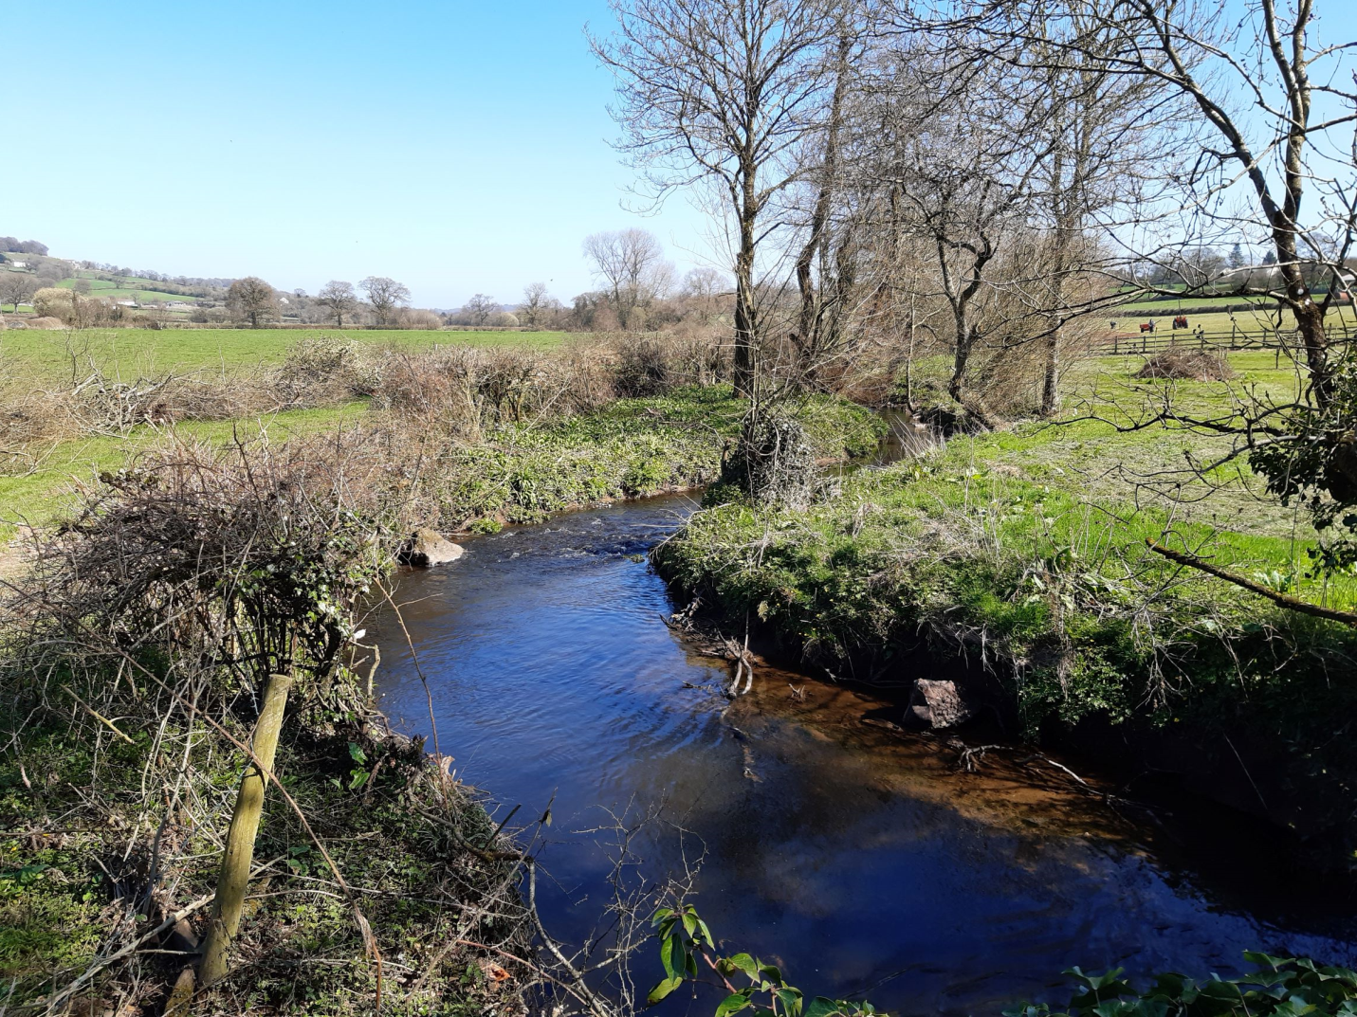
Activity: Using the photo, consider the options for attenuating runoff to reduce the responsiveness of the River Culm to rainfall events.
(Culm SR 01)

Slide 5
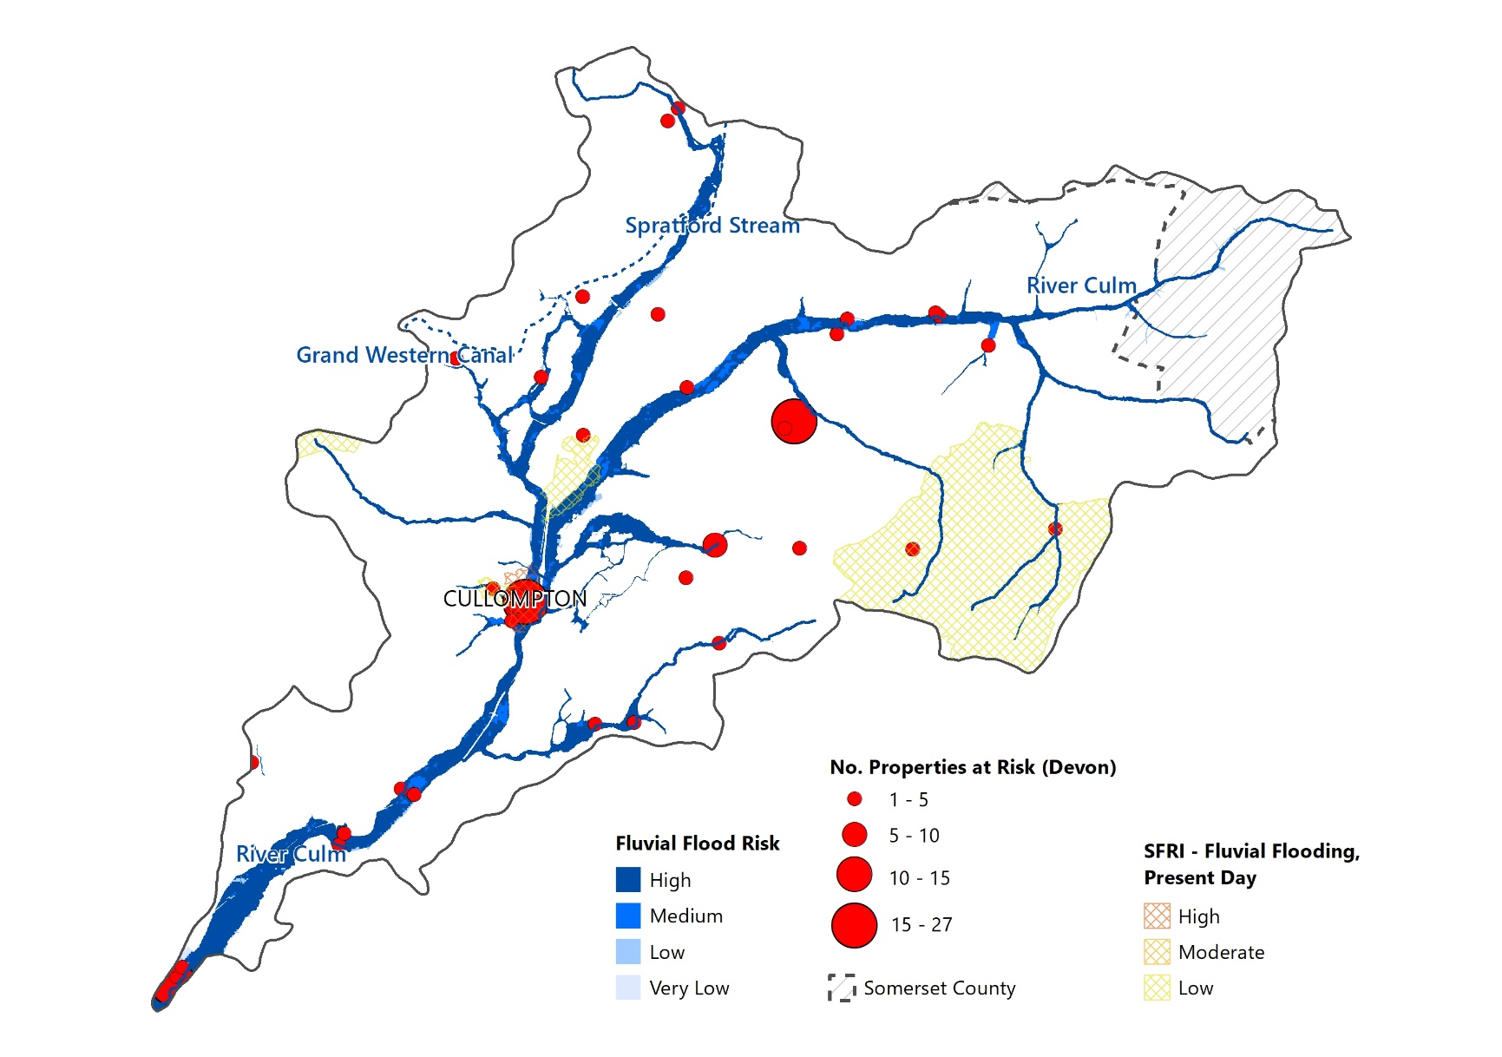
Activity: (a) Describe the flood risk in the River Culm Catchment. (b) Suggest reasons for the variability in flood risk across the catchment.

Slide 6
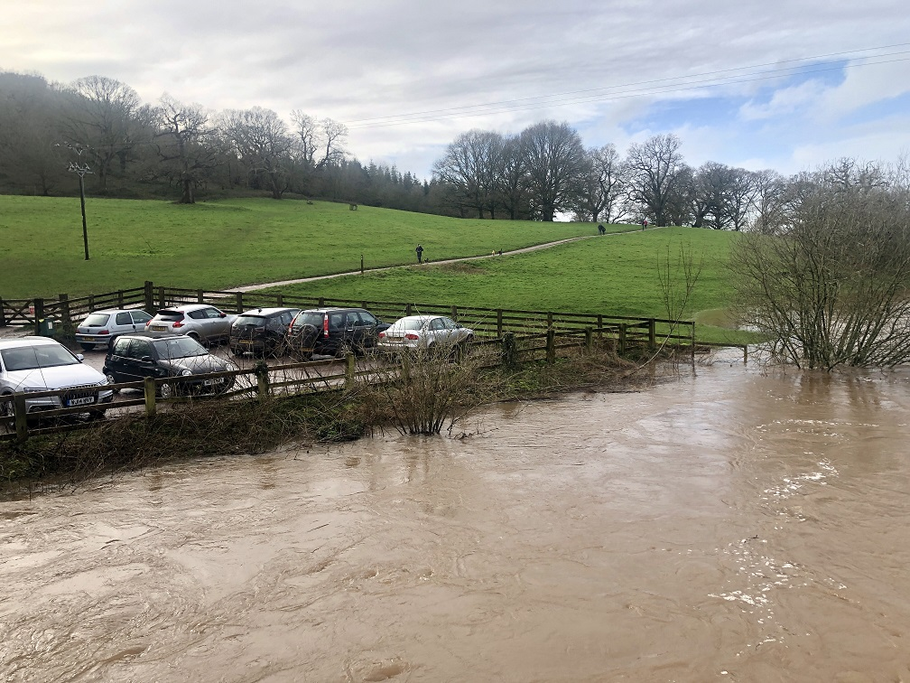
Activity: Using the photo, evaluate how the effects of climate change on drainage basin stores and transfers may affect the risk of flooding in the River Culm catchment.

Slide 7
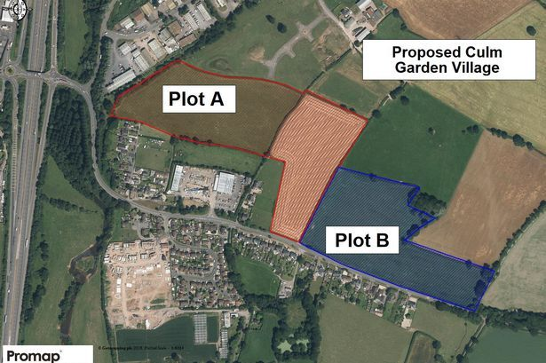
Activity: Using the photo, assess how urban developments associated with the proposed Culm Garden Village may affect the water cycle in the River Culm catchment.

Slide 8
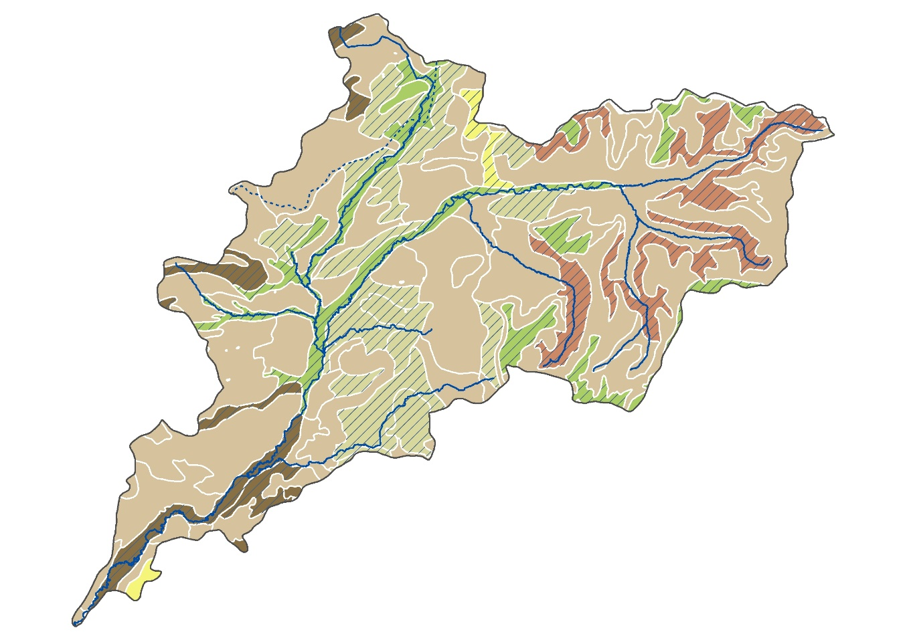
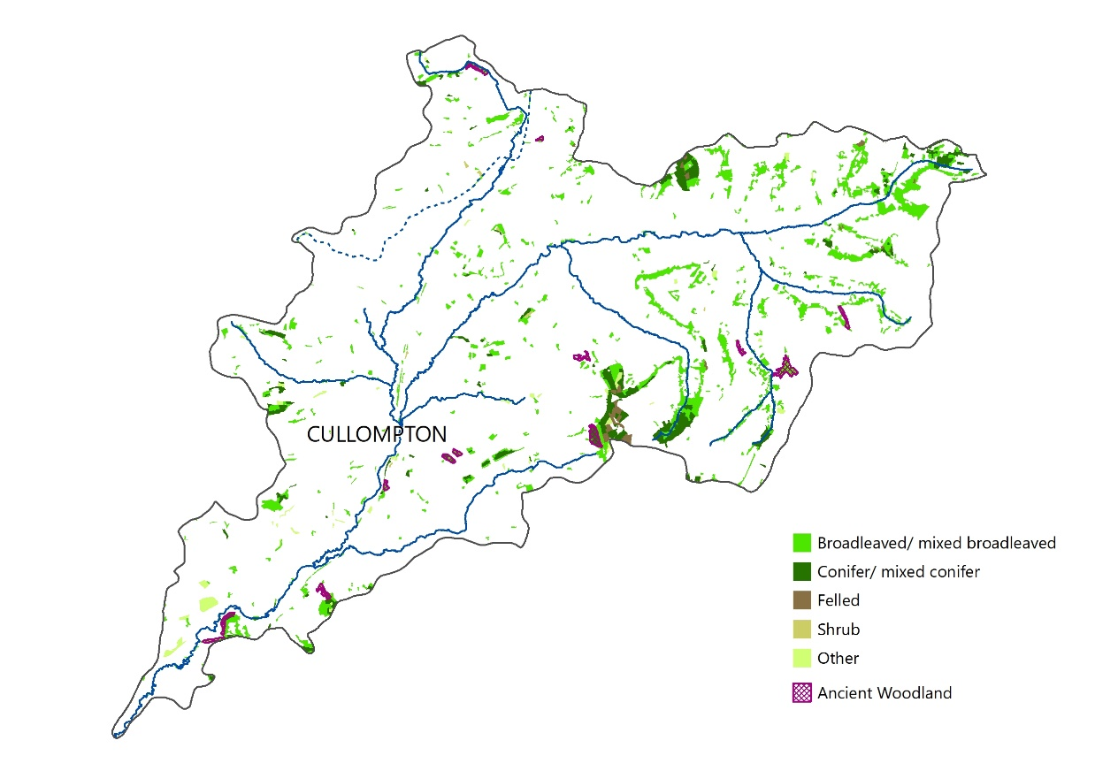
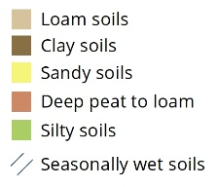
Activity: With reference to the maps below, discuss the importance of woodland and soils in accounting for the relatively high proportion of runoff associated with the River Culm catchment.

Slide 9
Activities
Further student activities may include:
Using a simple diagram, outline the role of river basins within the global water cycle.
Draw a sketch of the River Culm’s river regime (annual hydrograph). Write annotations to describe and suggest reasons for its pattern.
With reference to the drainage basin system, evaluate the physical factors contributing to the Culm’s responsiveness to winter rainfall and the risk of flooding.
Evaluate the importance of human factors such as farming and urbanisation in contributing to the high proportion of runoff experienced in the River Culm catchment. To what extent has this impacted on water quality in the Culm Catchment?
Suggest how SUDS may mitigate the problem of flooding in urban river catchments.
Assess the role of nature-based solutions in attenuating runoff and reducing the risk of flooding.
Investigate the River Culm’s river regime using the interactive gauging station data at https://riverlevels.uk/river-culm-culmstock#.YQwSyYj0mUk
Geography NEA
There are several opportunities for individual research enquiries focusing on the water cycle in small river basins such as the River Culm. For example, comparative studies can be made of infiltration rates in different types of soil or on different slopes. Interception can be studied under different types of tree to assess which is most effective. (See https://www.geography-fieldwork.org/a-level/water-carbon/hydrology/method/ for further details).
Journey along Culm from Uffculme to Culmstock - https://www.youtube.com/watch?v=hhN-gSE8lus
Aerial Dimensions - https://connectingtheculm.com/discover-the-culm/

Slide 10
References
The Connecting the Culm online library has an extensive range of useful information at https://connectingtheculm.com/library/
The very extensive Connecting the Culm Environmental Evidence Review (2021) is the primary source for some aspects of the student Powerpoint presentation at https://connectingtheculm.com/ctc-evidence-review-1stedition-feb2021_logos/
For general information on the water cycle, NOAA has an excellent collection of materials at https://www.noaa.gov/education/resource-collections/freshwater/water-cycle. All A level textbooks and many online A level support sites provide additional information on the water cycle.
The Met Office has a good introduction to the water cycle at https://www.metoffice.gov.uk/weather/learn-about/weather/how-weather-works/water-cycle
For suggestions to support NEA enquiries, see the Field Studies Council website at https://www.geography-fieldwork.org/a-level/water-carbon/hydrology/method/

Slide 11
Water Cycle – A-level resource pack
River Culm catchment
Student Slides

Slide 12
Global water cycle
The water cycle describes the continuous movement of water between the Earth and the atmosphere.
It is an example of a closed system, with no external inputs or outputs.
The drainage basin (catchment) hydrological cycle forms part of the global water cycle.
https://www.usgs.gov/special-topic/water-science-school/science/fundamentals-water-cycle

Slide 13
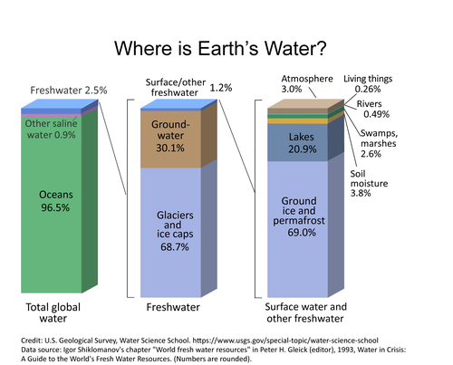
Distribution of Earth’s water
About 71% of the Earth’s surface is water, predominantly oceans.
The vast majority of the Earth’s water is stored in oceans (96.5%).
Of all freshwater, almost 99% is stored as ice and groundwater.
Of all surface water and other freshwater (1.2% of the Earth’s freshwater), just 3% is stored in the atmosphere and 0.49% in rivers.
https://prd-wret.s3.us-west-2.amazonaws.com/assets/palladium/production/s3fs-public/styles/atom_page_medium/public/thumbnails/image/EarthsWater-BarChart.png

Slide 14
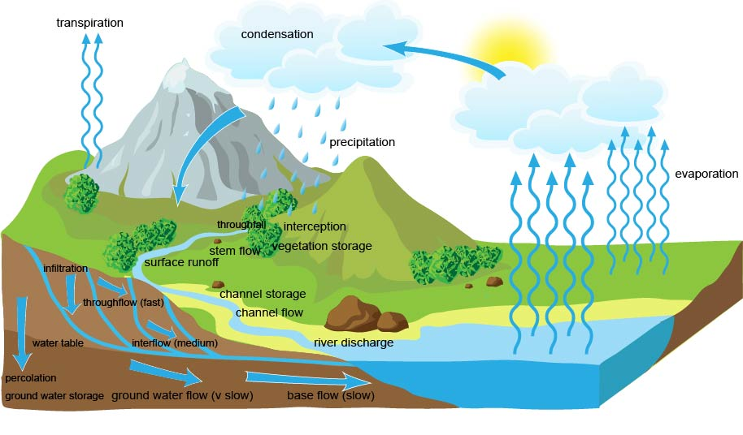
Drainage basin system
The drainage basin (catchment) system comprises inputs (e.g. precipitation), outputs (e.g. evaporation) and transfers (e.g. throughflow).
The magnitude of stores and transfers varies according to individual drainage basin characteristics, such as geology, vegetation and urbanisation.
Understanding drainage basins is important in water supply, water quality and flood management.
https://www.alevelgeography.com/drainage-basin-hydrological-system/

Slide 15
Drainage basin system – key terminology
Precipitation – transfer of water from the atmosphere to the ground (rain, snow, dew)
Evaporation – change in state from water liquid to water vapour
Condensation – change in state from water vapour to water droplets (liquid)
Interception – precipitation intercepted most commonly by trees and plants
Throughfall – water dripping through trees to the ground
Stemflow – water dripping down plant stems or tree trunks
Surface runoff – water flowing over the ground surface
Infiltration – water soaking into the soil from the ground surface
Throughflow/interflow – water draining through the soil above the water table
Water table – upper level of (underground) water stored in rock and/or soil
Groundwater/base flow – water passing slowly through rocks
River discharge – volume of water (cubic metres/sec) flowing in a river

Slide 16
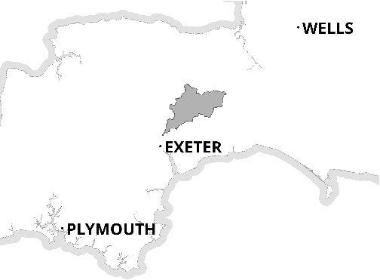
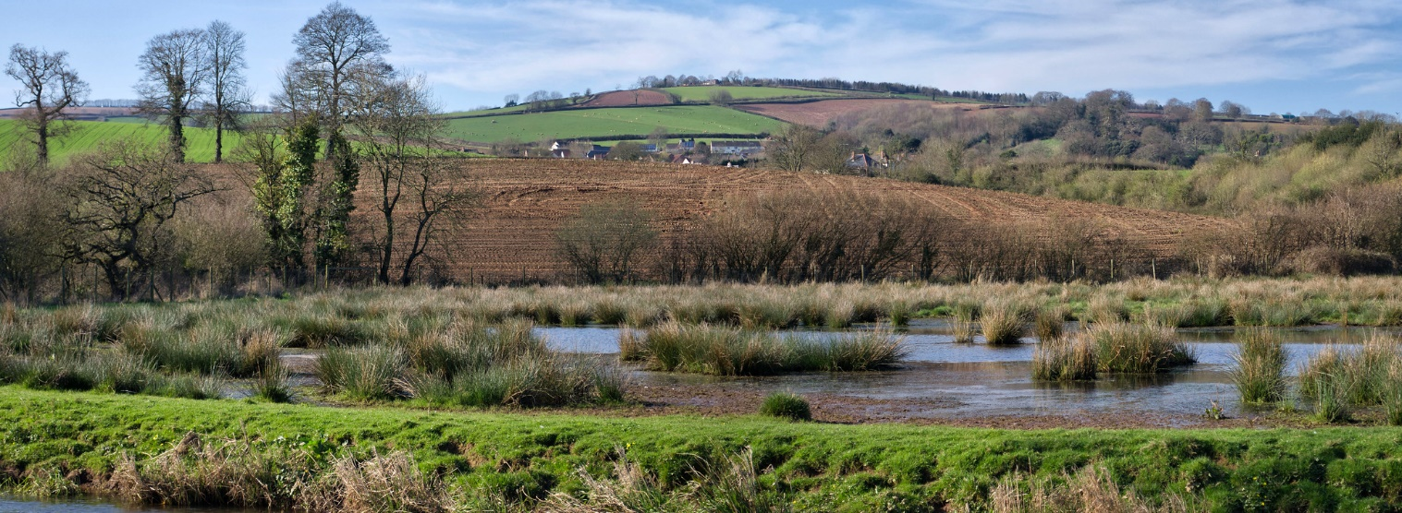
The River Culm drainage basin
The River Culm flows through the ‘Redlands’ of Mid and East Devon.
It is the longest tributary of the River Exe and drains an area of 280 square km.
The river rises at a spring near RAF Culmhead in the Blackdown Hills. From here it flows through Hemyock and Cullompton to join the River Exe to the north-west of Exeter.
The catchment is predominantly rural, comprising mixed woodland and agricultural (mostly pasture).
N

Slide 17
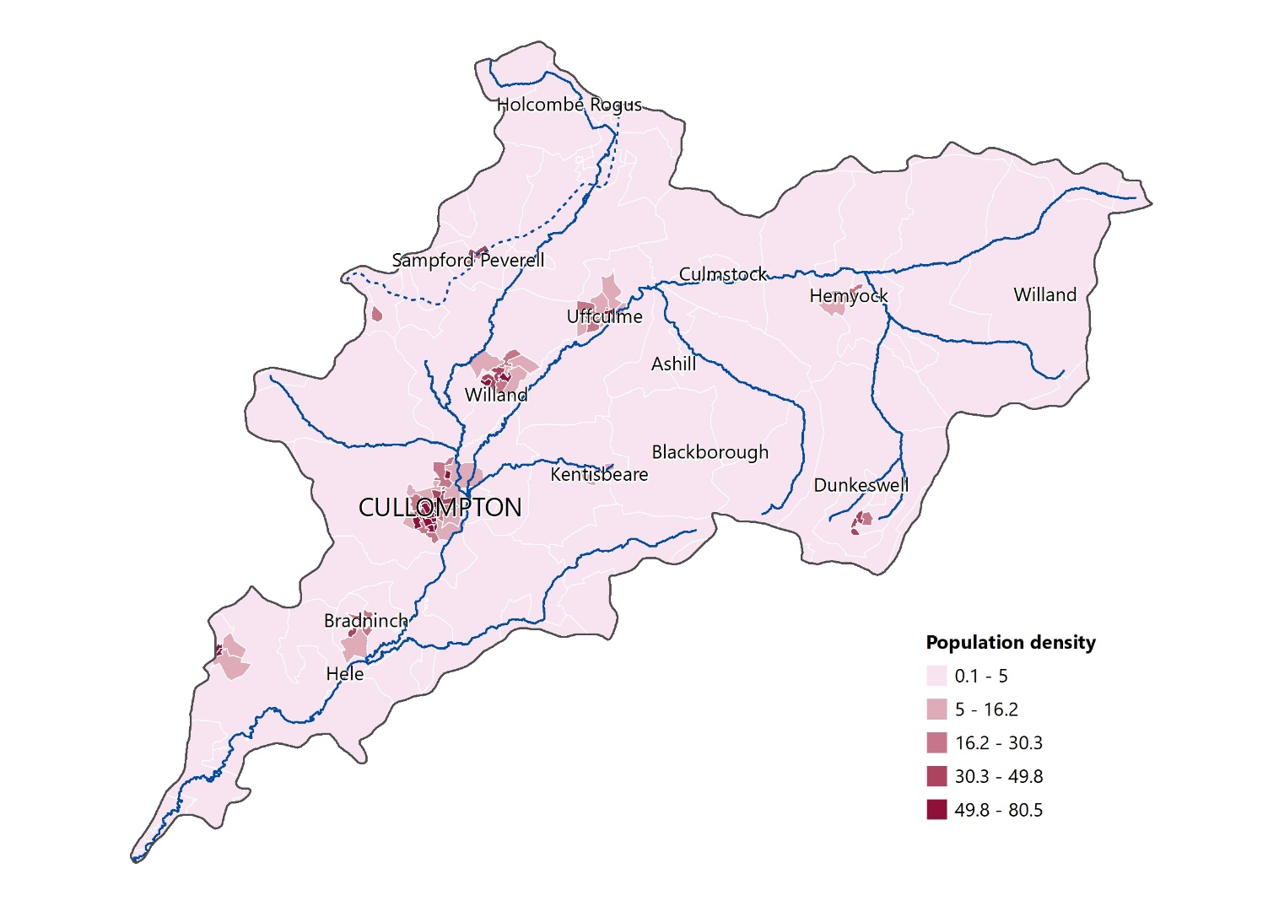
People in the Culm Catchment
The water cycle interacts with people and human activities.
Water resources – water is abstracted from natural stores such as rivers, lakes and aquifers. These are supplemented by artificial reservoirs. In the Culm catchment, most freshwater is stored in rivers.
People’s activities, such as agriculture and urbanisation impact water quantity and quality.
Flooding is an example of the impact of the water cycle on people and human activities.

Slide 18
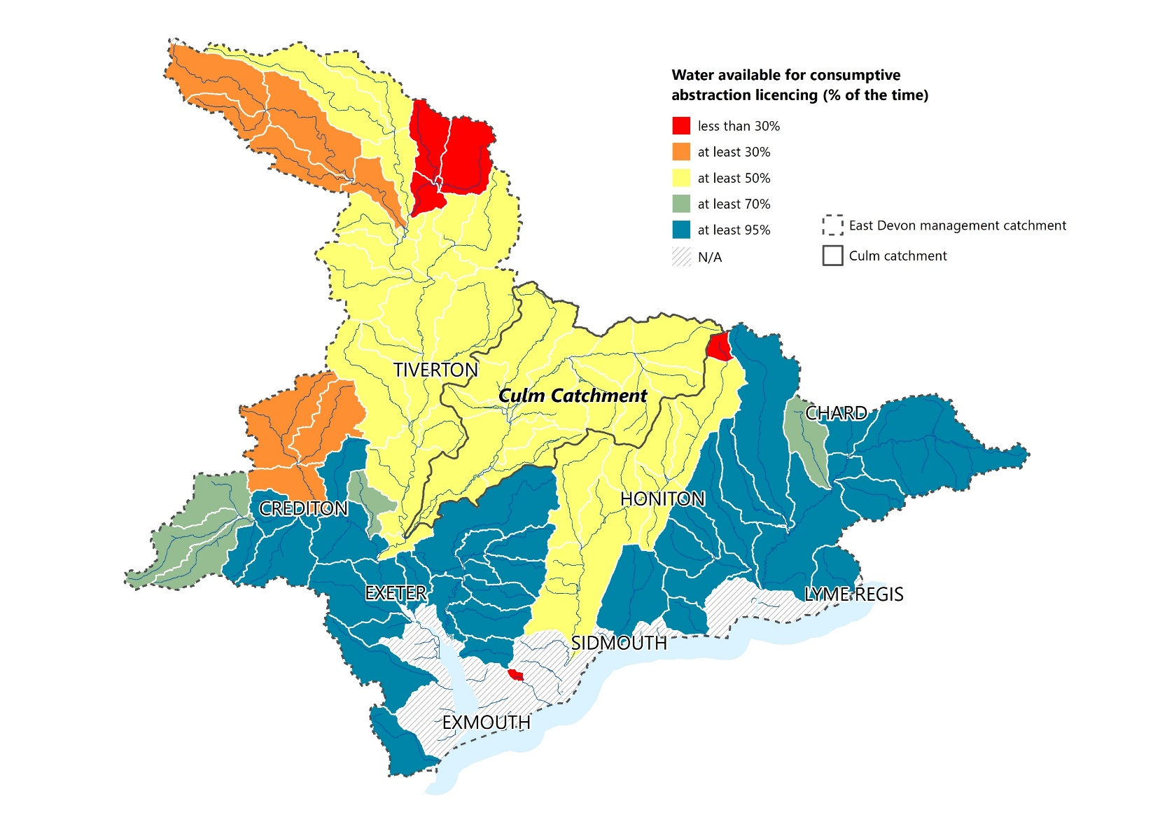
Water resources in the Culm Catchment
The Environment Agency is responsible for managing water resources in England.
Water availability and abstraction reliability datasets are used to formulate catchment abstraction management plans.
These plans form part of an overall Catchment Abstraction Management Strategy (CAMS).
The Culm Catchment is classified as having water available for consumptive abstraction for 50% of the time.

Slide 19
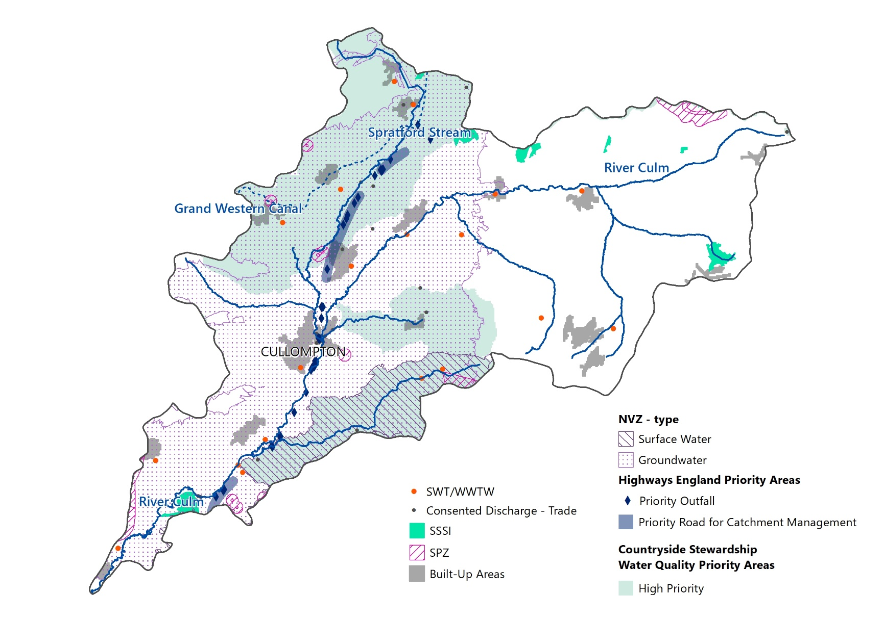
Water quality in the Culm Catchment
There are three areas in a catchment where degradation of water quality can result in a loss of good water quality as an ecosystem service:
Within the aquatic ecosystem
At downstream locations in the river system (where chemicals may have been washed into the river)
Where water is abstracted from rivers and reservoirs.
SSSI – Site of Special Scientific Interest
SPZ – Source Protection Zones
NVZ – Nitrate Vulnerable Zones

Slide 20
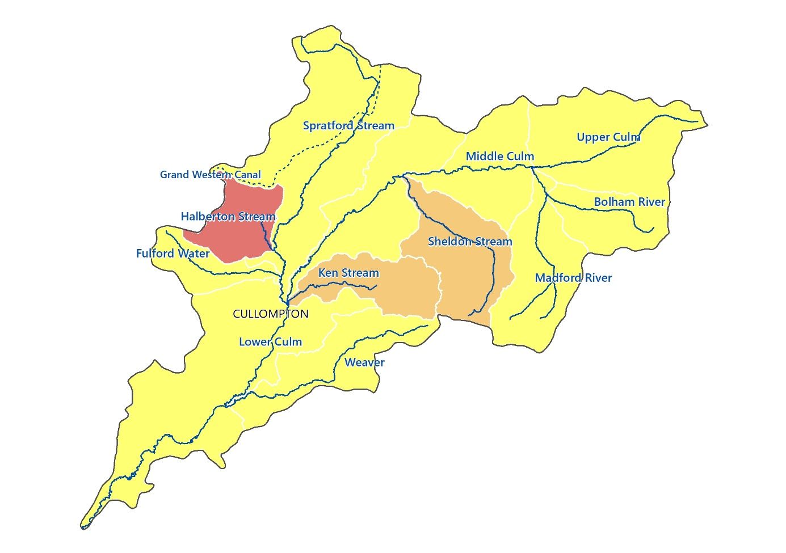
Water quality in the Culm Catchment
The map shows water quality assessments for the Culm Catchment in 2016 and 2019.
With the majority of the catchment rated as moderate or worse, it has failed to reach a good chemical status.
Much of this is the result of chemical pollutants reaching river courses from agricultural land.
Three examples of water quality assessment are presented on the map.
Halberton Stream |  |  | 16 | 19
Overall status
 | Ecological status
 |  | Fish
 |  | Invertebrates
 |  | Phosphate
 | Chemical status
Key
 | High
 | Good
 | Moderate
 | Poor
 | Bad
Bolham River |  |  | 16 | 19
Overall status
 | Ecological status
 |  | Fish
 |  | Invertebrates
 |  | Phosphate
 | Chemical status
Sheldon Stream |  |  | 16 | 19
Overall status
 | Ecological status
 |  | Fish
 |  | Invertebrates
 |  | Phosphate
 | Chemical status

Slide 21
Flood risk in the Culm Catchment
The release of water from land and into rivers can pose a threat to people living in the catchment and cause community disruption.
Properties and infrastructure can be mapped and cross-referenced with flood risk zones to identify where there is a risk of damage or disruption. People can increase levels of preparedness to minimise potential impacts.
The map alongside shows the areas at greatest risk from flooding and the number of properties at risk.

Slide 22
River Culm (Culmstock) - river regime
The graph shows long-term river levels of the River Culm at Culmstock.
The usual range (90% occurrence) is between 0.17m and 0.7m (green line).
Highest level ever recorded is 2.17m (21 November 2012).
The graph indicates winter peaks of discharge which account for all occasions when levels exceeded 0.7m.
The River Culm responds quickly to winter rainfall events, when soils are saturated and vegetation growth in minimal.
https://riverlevels.uk/river-culm-culmstock#.YQwSyYj0mUk

Slide 23
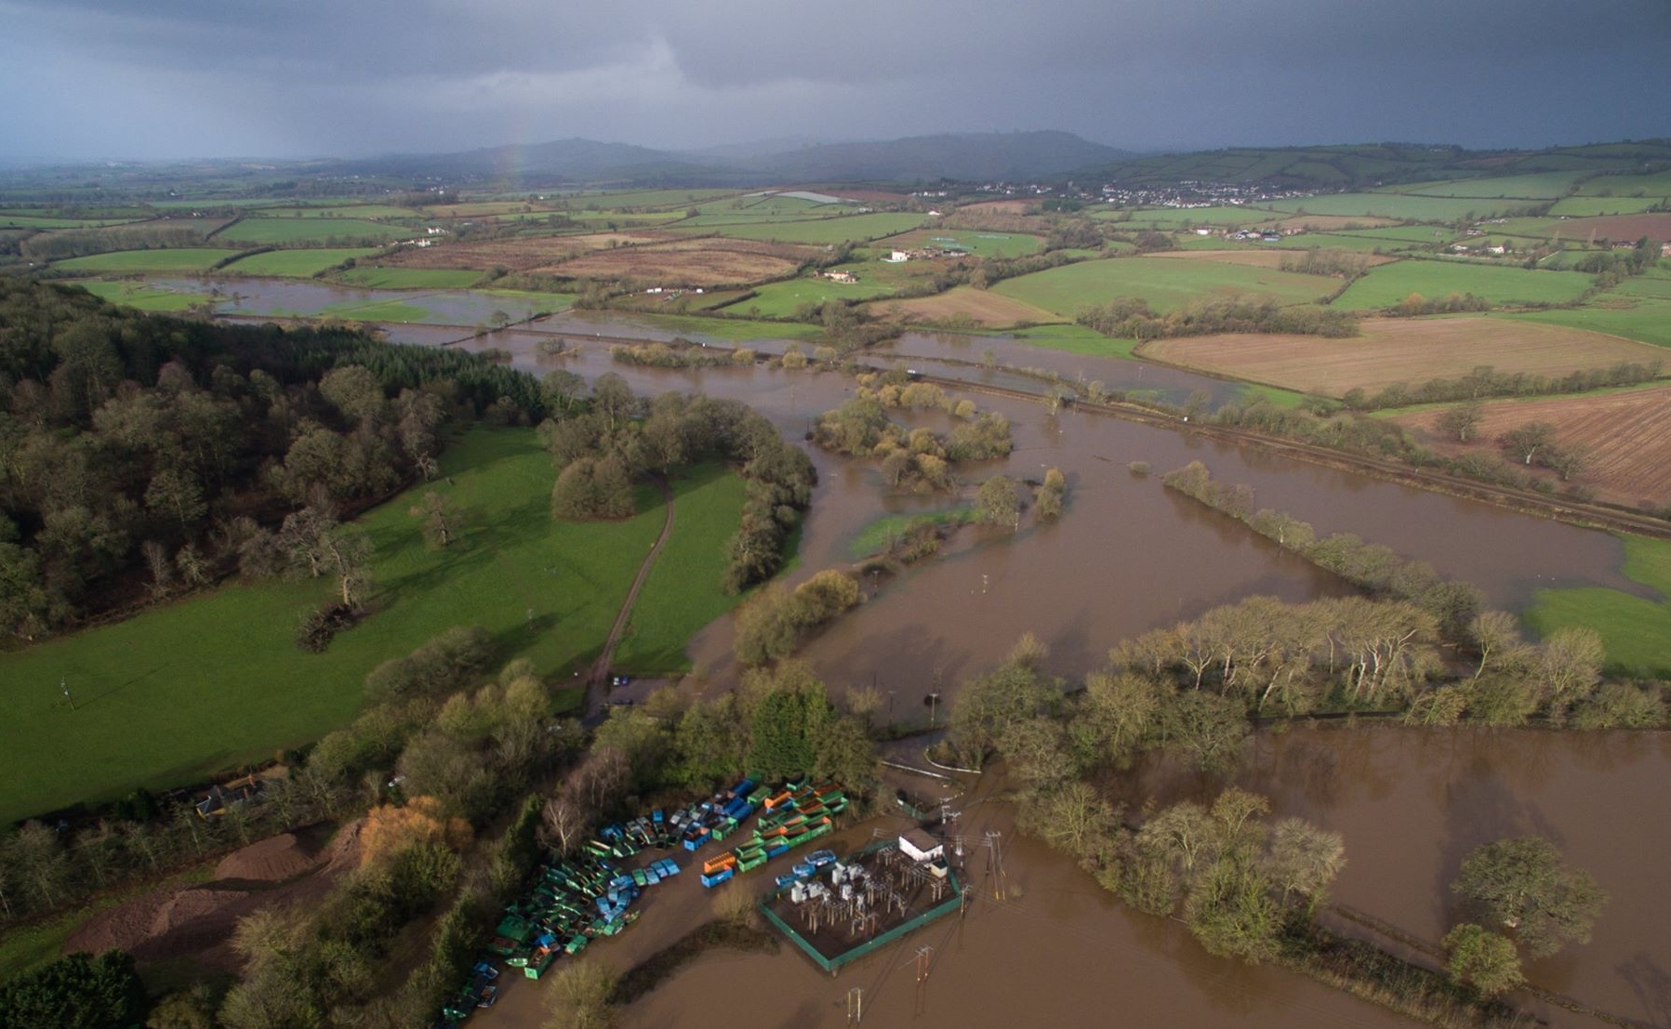
River Culm flooding near Hele, 2016
https://wrt.org.uk/wp-content/uploads/2019/07/culm-flood-feb-2016-3.jpg

Slide 24
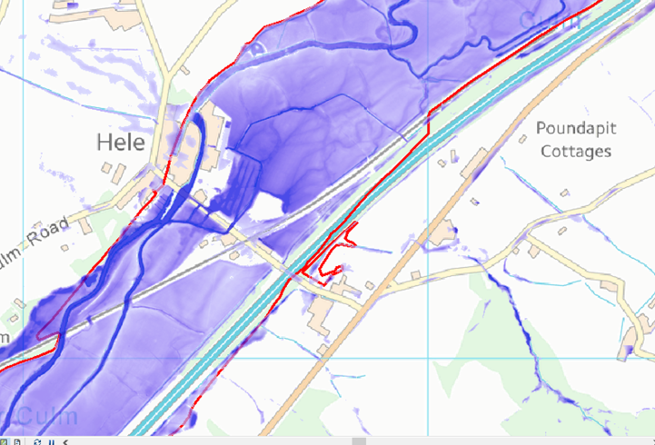
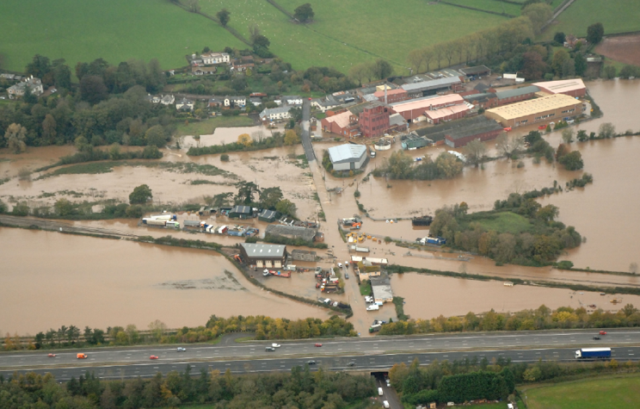
Flooding at Hele, 2012
Flooding at Hele in 2012 resulted in the temporary closure of the mainline railway connecting
the south-west to the rest of the UK. Property and industrial premises were inundated.
https://connectingtheculm.com/climate-change-and-the-river-culm/

Slide 25
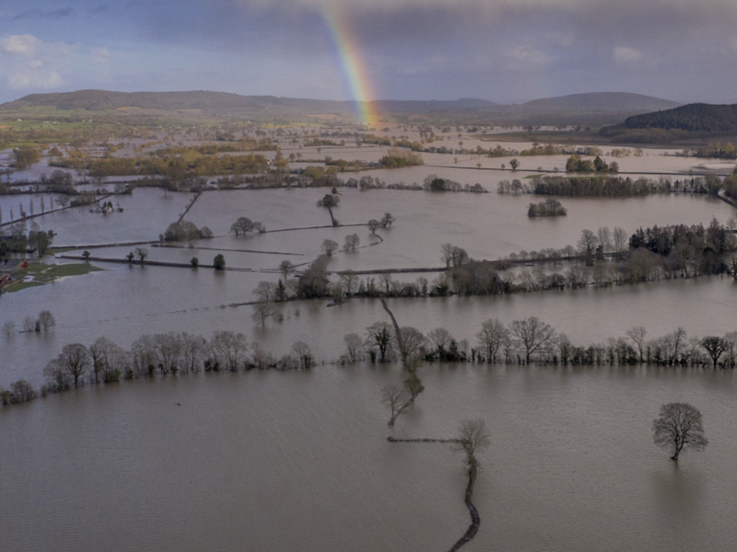
Why is the River Culm so ‘flashy’?
River Culm floods, 2012
River levels (and discharge) respond quickly to significant rainfall events, especially in the winter period.
As a result, the river regime can be described as ‘flashy’, with river levels rising and falling quite rapidly in a few hours.
Minor flooding over fields, and occasionally roads, is common
Factors contributing to the River Culm’s flashy nature includes geology, soils, land use and urbanisation.
Climate change poses significant challenges for the future.
https://connectingtheculm.com/climate-change-and-the-river-culm/

Slide 26
Factors contributing to flooding of the River Culm
There are several factors contributing to flooding and to the relatively ‘flashy’ nature of the river in response to rainfall events:
Geology
Soils
Land use (including urbanisation)
Climate change is likely to impact on the river’s future responsiveness as rainfall is likely to increase in volume and intensity.
Nature-based solutions offer sustainable options for adaptation.

Slide 27
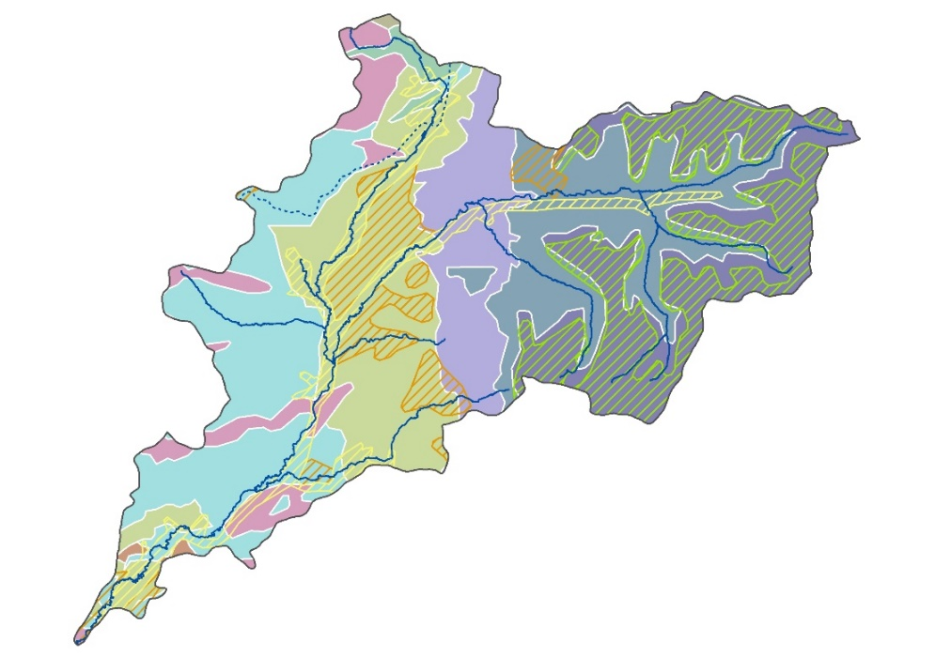
River Culm catchment - geology
Diamicton deposits are impermeable ‘clay caps’ that increase surface runoff and increase the risk of flooding in the upper, eastern parts of the catchment.
The presence of diamicton (impermeable clay caps) in the upper catchment promotes rapid runoff,
increasing the flood risk downstream.

Slide 28
River Culm catchment - soils
Soils have the potential to store water, reducing surface runoff and lowering the flood risk.
Loam and sandy soils are permeable enabling water to infiltrate and transfer more slowly than surface runoff.
Clay soils are impermeable and can become saturated and waterlogged increasing surface runoff.
Peaty soils, associated with wetland mires, store water effectively thereby reducing the flood risk.

Slide 29
River Culm catchment: land use
The majority of the Culm catchment is agricultural (87%) comprising improved grassland (62%) and arable (25%).
Intensive agriculture practises can lead to soil compaction increasing the flood risk.
Woodland covers 9% of the catchment
Urban and suburban land uses comprise about 4% only, however, impermeable surfaces and drains can exacerbate the local flood risk.

Slide 30
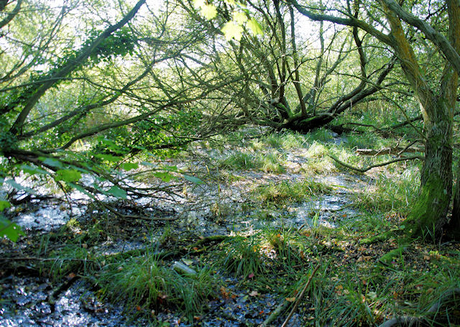
River Culm catchment - soils and farming
Natural wet woodland habitat in the Upper Culm
Intensive farming on the upland clay plateau has compacted soils, promoting surface runoff and increasing the flood risk
Heathland and woodland restoration help to increase soil permeability.
In the lowland catchment (Triassic mudstones and Permian sandstones), soil erosion is an issue reducing permeability.
Maize (animal fodder) is harvested late often during wet conditions. This leads to compaction and reduces soil permeability, increasing the flood risk.
https://connectingtheculm.com/discover-the-culm/

Slide 31
River Culm catchment - urbanisation
In 2017, the government announced plans for several new ‘Garden Villages’ including Culm Garden Village in Cullompton.
The new village will provide up to 5,000 new homes together with shops, employment, schools and health care facilities.
Urbanisation can increase surface runoff by replacing permeable surfaces with concrete and tarmac.
New developments need to address the issue by developing Sustainable Drainage Systems (SuDS) involving permeable surfaces and flood storage and other Nature-Based Solutions (NBS)
https://www.devonlive.com/news/devon-news/culm-valley-garden-village-300k-2555847

Slide 32
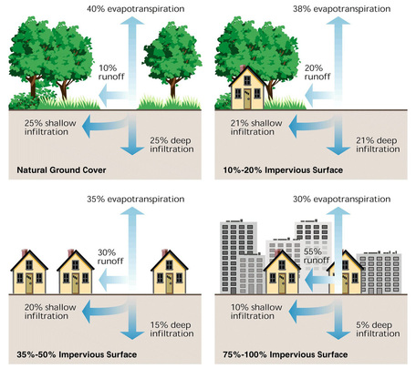
Impact of urbanisation on the water cycle
The process of urbanisation has significant impacts on stores and transfers in the water cycle:
Removal of vegetation reduces interception, evapotranspiration and infiltration. Surface runoff is increased.
Replacing vegetation with artificial impermeable surfaces reduces infiltration and increases surface runoff.
Urbanisation can speed up the transfer of water and increase the flood risk.
http://thebritishgeographer.weebly.com/hydrographs-recurrence-intervals-and-drainage-basin-responses.html

Slide 33
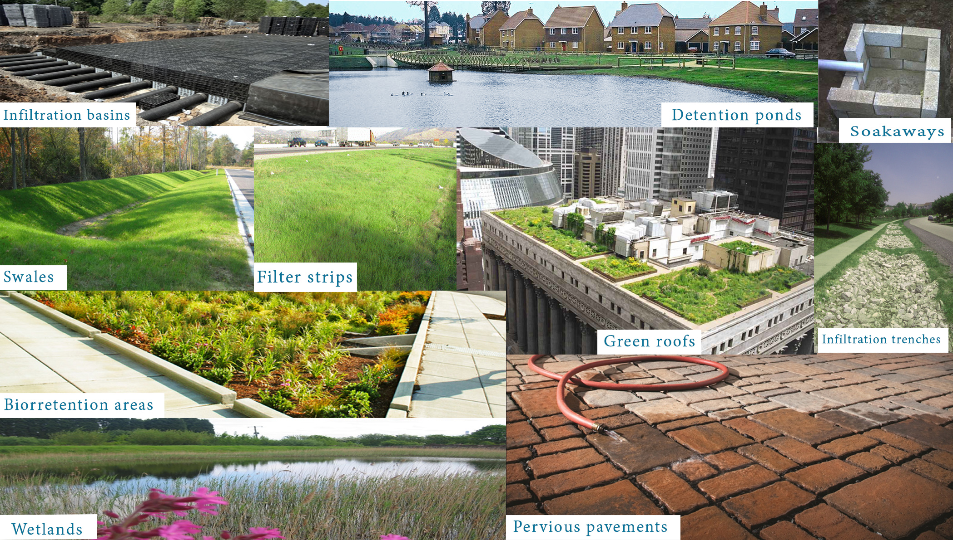
Sustainable Drainage Systems (SuDS)
Sustainable Drainage Systems (SuDs) helps reduce surface runoff from urban areas like the proposed Culm Garden Village.
Infiltration in the soil, and water storage is encouraged.
The diagram shows ten ways that runoff can be reduced by sustainable drainage systems.
Sustainable Drainage Systems – SuDS – Hidrología Sustainable (hidrologiasostenible.com)

Slide 34
Climate change and flood risk
Flooding at Killerton
Climate change is already having an impact in the South West:
Average annual rainfall is 10% higher than in 1961.
Rainfall is becoming more seasonal, with a decrease of 9% in summer and increase in autumn (28%) and winter (16%).
Winters are milder, with 21 fewer air frost days than in 1961.
By 2080, winter rainfall will increase (20-50%) and summer rainfall decrease (30-40%). This may increase the risk of winter flooding.
https://connectingtheculm.com/discover-the-culm/

Slide 35
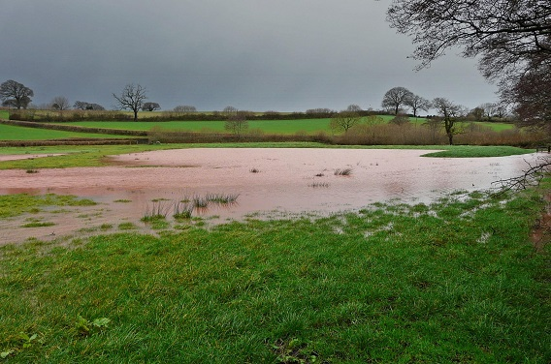
Attenuating runoff – nature-based solutions
Flood water storage using bunds at Holnicote Estate
Attenuating (slowing down) runoff reduces the risk of flooding:
Creating high flow pathways to areas of high soil permeability
Using bunds or the natural topography to temporarily store water
Restoration of natural channels to create wetland storage
Tree planting – soils in woodlands are x67 more absorbent to water than compacted soils due to dense root networks and deep humus layer
https://connectingtheculm.com/discover-the-culm/
Nature-based solutions involve sustainable management
strategies that work with natural processes.

